Slide 1


Project presentation
ENGI 9805 – Computer Vision

Slide 2
Project : Motion Detection
using webcam
INSTRUCTOR : Ebrahim Karami
Group Members : Utkarsh Trivedi Sona Pujari
Shujhana Mostafa

Slide 3
Topics of presentation
1. Introduction
2. Problem 3. Solution 4. Block Diagram 5. Results
ENGI 9805 – Computer Vision

Slide 4
Introduction
Motion Detection is hard as a machine only is not able to distinguish like a human mind about a moving object.
Instead of manual operations like security, moving object detection, etc. motion detection can be helpful.
Further enhancements can help the machine learning prospects using dataset for gathering information about behaviour and other prospects for future use.
ENGI 9805 – Computer Vision

Slide 5
Problem
The main issue to begin with is to make a machine understand which part of the frame is moving with respect to overall frame.
So we need to train at first, how to distinguish the difference of motion in the frame.
The other minor problem that can be mentioned along with the above major one is that disturbances in the frame have to be removed as well for better enhancement.
ENGI 9805 – Computer Vision

Slide 6
Solution
The first step of the solution as per our implementation is to capture the video from webcam and convert it to gray scale.
Also we are applying a gaussian blur to reduce the distortion from the captured frames.
After this we are implementing the delta frame which calculates difference in between first frame and gray scale frame.
ENGI 9805 – Computer Vision

Slide 7
From the delta frame we use it for the production of threshold frame using the threshold binary method in OpenCV.
Then by using a for loop we have implanted the contours which help in detection and improvement of white spaces in threshold frame.
We also implement the counter and the rectangle inside the same loop. At the end we are converting the delta frame back to gray scale for usage.
ENGI 9805 – Computer Vision

Slide 8
The usage of all the method done is from different python libraries and OpenCV.
The captured values from the video frames where motion is detection is imported to an excel sheet in csv file which can be further used to implement the bokeh graph.
The resulting images which are produced at the end along with bokeh graph are able to successfully capture motion detection in a captured video frame using a webcam.
ENGI 9805 – Computer Vision

Slide 9
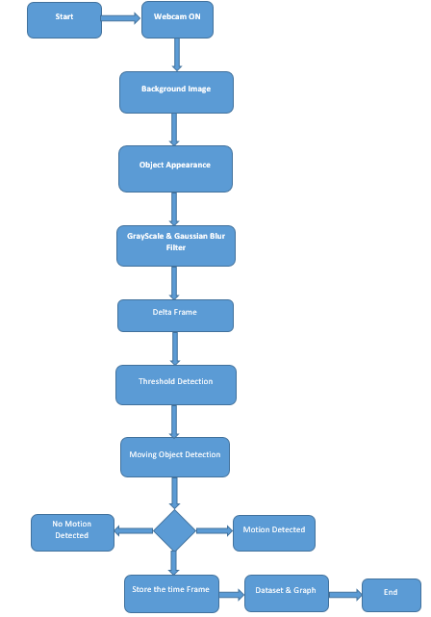
BLOCK DIAGRAM
ENGI 9805 – Computer Vision

Slide 10
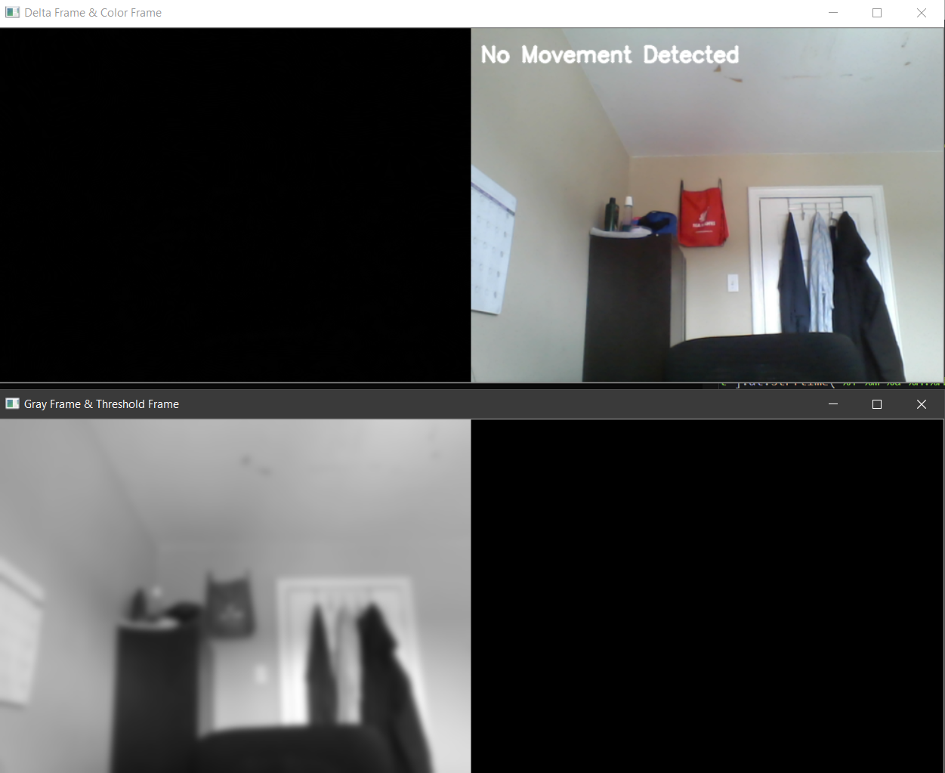
Results
ENGI 9805 – Computer Vision

Slide 11
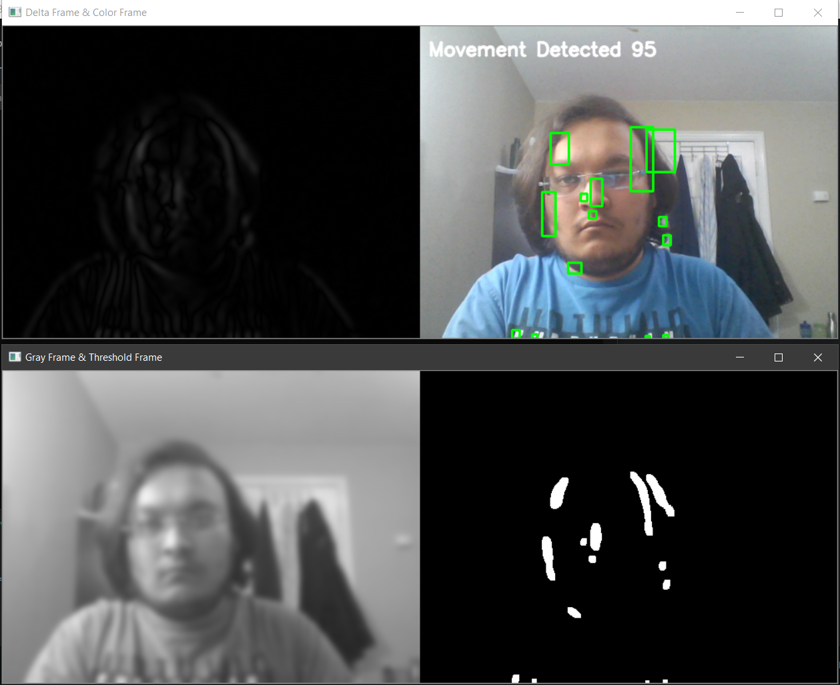
ENGI 9805 – Computer Vision

Slide 12
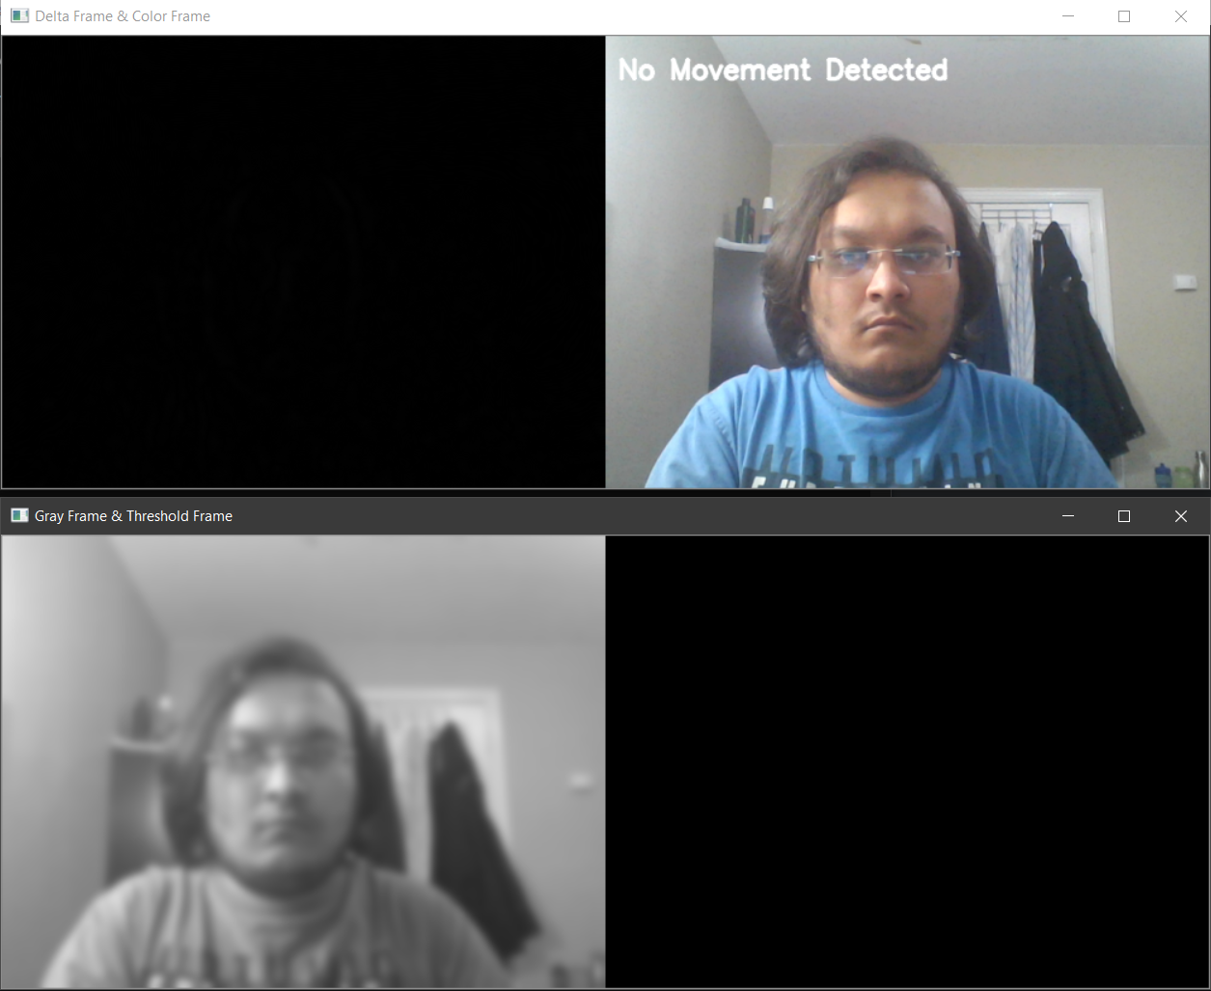
ENGI 9805 – Computer Vision

Slide 13
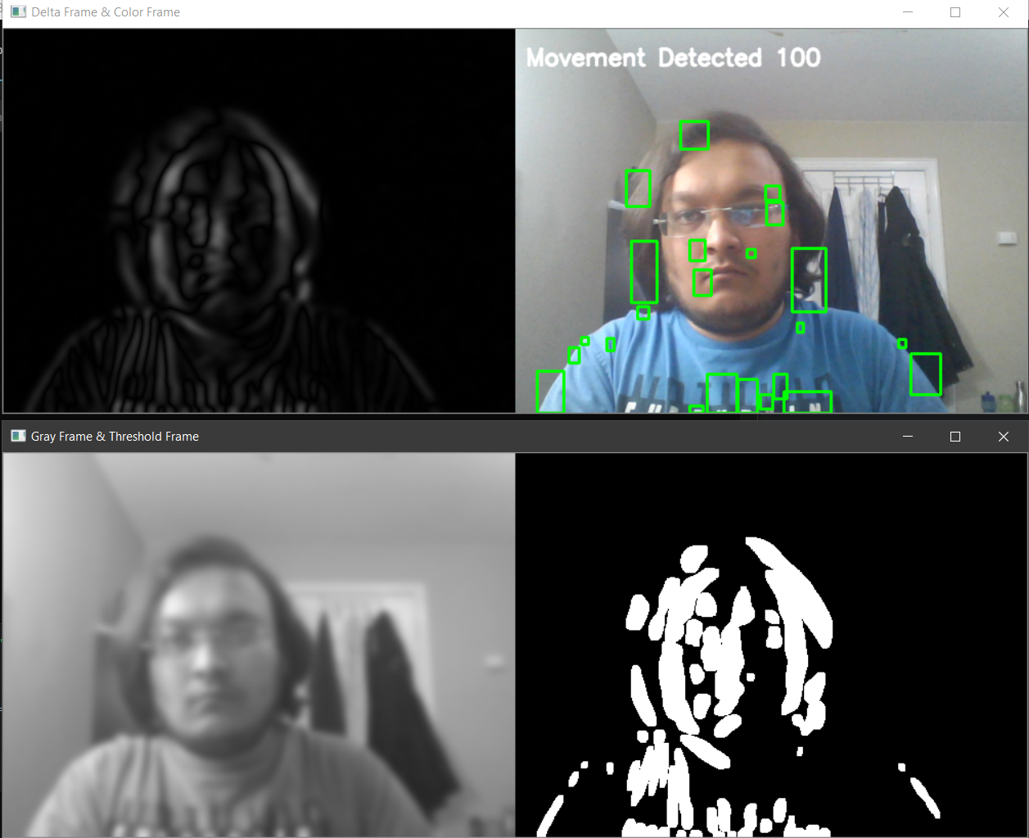
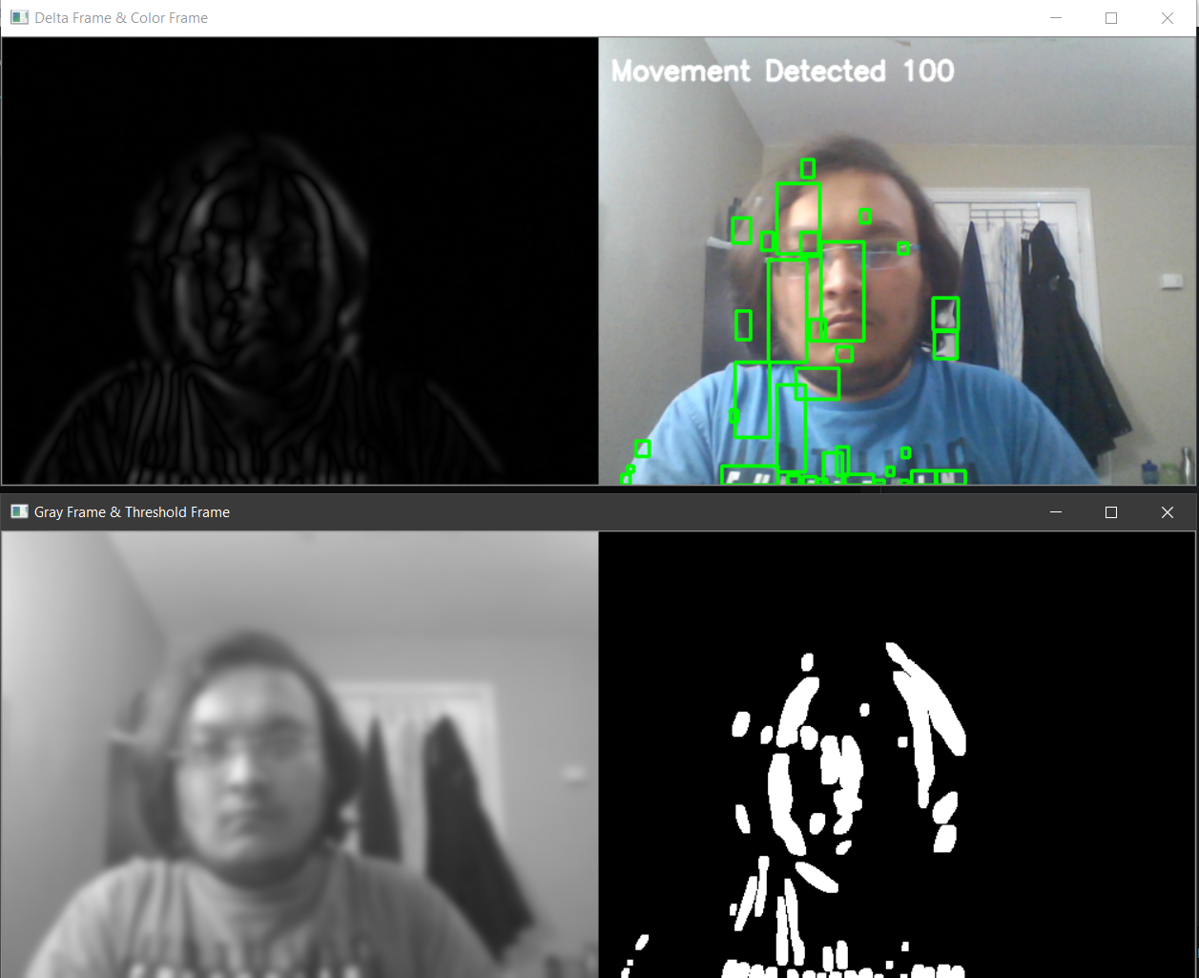
ENGI 9805 – Computer Vision

Slide 14
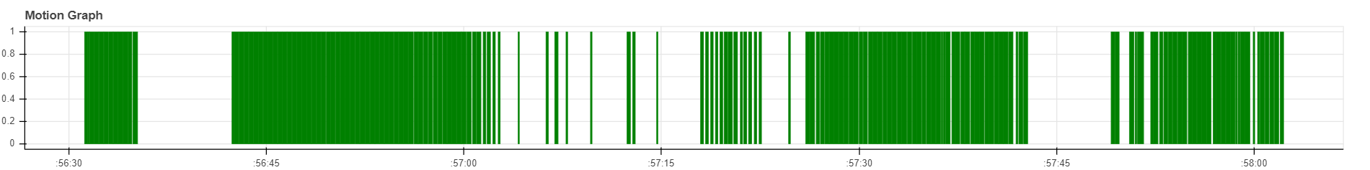
Bokeh Graph
ENGI 9805 – Computer Vision

Slide 15
Thank you
ENGI 9805 – Computer Vision

